Slide 1
The Constrained Longest Common Subsequence Problem
Yin-Te Tsai
Information Processing Letters 88 (2003), pp. 173~176
Presenter : Hsiang-Yi Weng
Date : April 30, 2008

Slide 2







Abstract
This paper considers a constrained version of longest
common subsequence problem for two strings. Given
strings , and , the constrained longest common
subsequence problem for and with respect to is
to find a longest common subsequence of and
such that is a subsequence of this . An time
algorithm based upon the dynamic programming technique
is proposed for this new problem, where and are
lengths of , and , respectively.

Slide 3
Longest Common Subsequence
 | = | a | b | c | a | b | c | a | b | c | d | g | h | d | a | b | e | j | i | i | h | f | a | b | c | a | b | c
 | = | g | d | h | i | j | e | j | e | i | f | a | b | c | a | b | c | a | b | c | a | b | c | a | b | c
LCS | = | a | b | c | a | b | c | a | b | c | a | b | c | a | b | c
Length : 15

Slide 4
Constrained Longest Common Subsequence
 | = | a | b | c | a | b | c | a | b | c | d | g | h | d | a | b | e | j | i | i | h | f | a | b | c | a | b | c
 | = | g | d | h | i | j | e | j | e | i | f | a | b | c | a | b | c | a | b | c | a | b | c | a | b | c
 | = | d | e | f
CLCS | ： | d | h | e | j | i | f | a | b | c | a | b | c
 |  | g | d | e | j | i | f | a | b | c | a | b | c
Length : 12

Slide 5

 | a | b | c | a | b | c | a | b | c | d | g | h | d | a | b | e | j | i | i | h | f
g
d
h
i
j
e
j
e
i
f
1
2
3
3
6

Slide 6
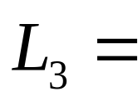
The algorithm
S₁ | = | a | b | c | a | b | c | a | b | c | d | g | h | d | a | b | e | j | i | i | h | f | a | b | c | a | b | c
S₂ | = | g | d | h | i | j | e | j | e | i | f | a | b | c | a | b | c | a | b | c | a | b | c | a | b | c
d h e j i f
g d e j i f

Slide 7
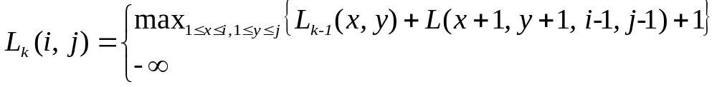
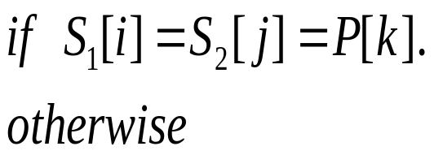
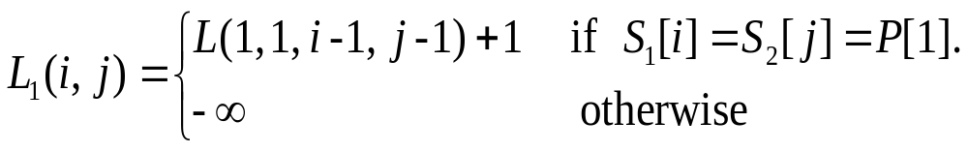
The algorithm
Lemma 1.

Slide 8
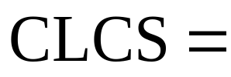
Lemma 2
S₁ | = | a | b | c | a | b | c | a | b | c | d | g | h | d | a | b | e | j | i | i | h | f | a | b | c | a | b | c
S₂ | = | g | d | h | i | j | e | j | e | i | f | a | b | c | a | b | c | a | b | c | a | b | c | a | b | c
d h e j i f
a b c a b c
g d e j i f
a b c a b c

Slide 9
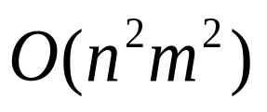
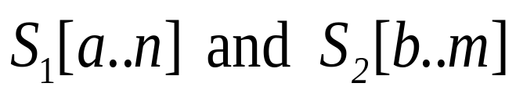
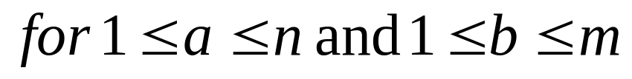
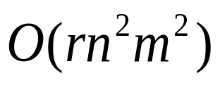
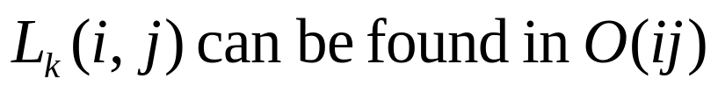
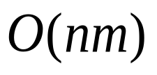
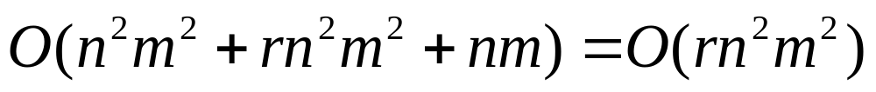
Theorem 1.
1. time
Computing the length of LCS of
2. time
3. time

